Slide 1
Unlimited possibilities of Power Apps Component Framework & React
Oleksandr Olashyn

Slide 2

Thank you, our Sponsor!

Slide 3






Introduction
Oleksandr Olashyn
CRM Architect, 3SHAPE
https://www.dancingwithcrm.com/
https://www.linkedin.com/in/dancingwithcrm/
https://twitter.com/dancingwithcrm
https://github.com/OOlashyn

Slide 4
What is Power Apps Component Framework
“One unified framework across model-driven and canvas apps which enables first- and third-party developers to build responsive and reusable components using their choice of libraries and services.”
Source: Microsoft

Slide 5
What is Power Apps Component Framework
Advantages of PCF
Support of modern web practices
Reusability
Optimized for performance
Access to rich set of APIs
Modern tooling (CLI)

Slide 6
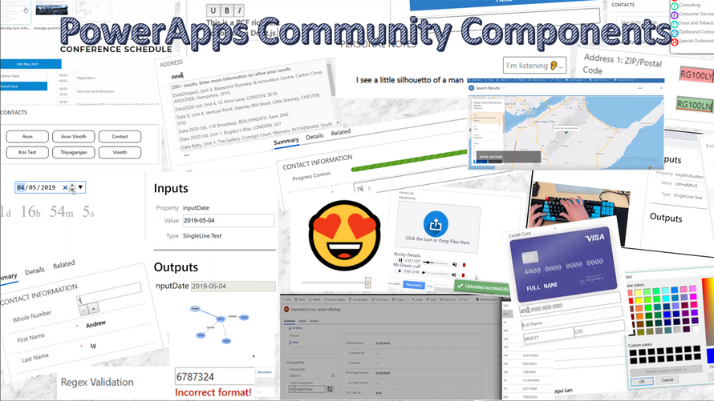
Community
https://aka.ms/PCFForum
Notes:
I am not the only one who was excited about PCF. Since the announcement of the framework back in April 2019, a big community grew around it. More than 100 components were created by the community. You can join the official PCF forum and find a lot of useful things here using the link on the screen.

Slide 7
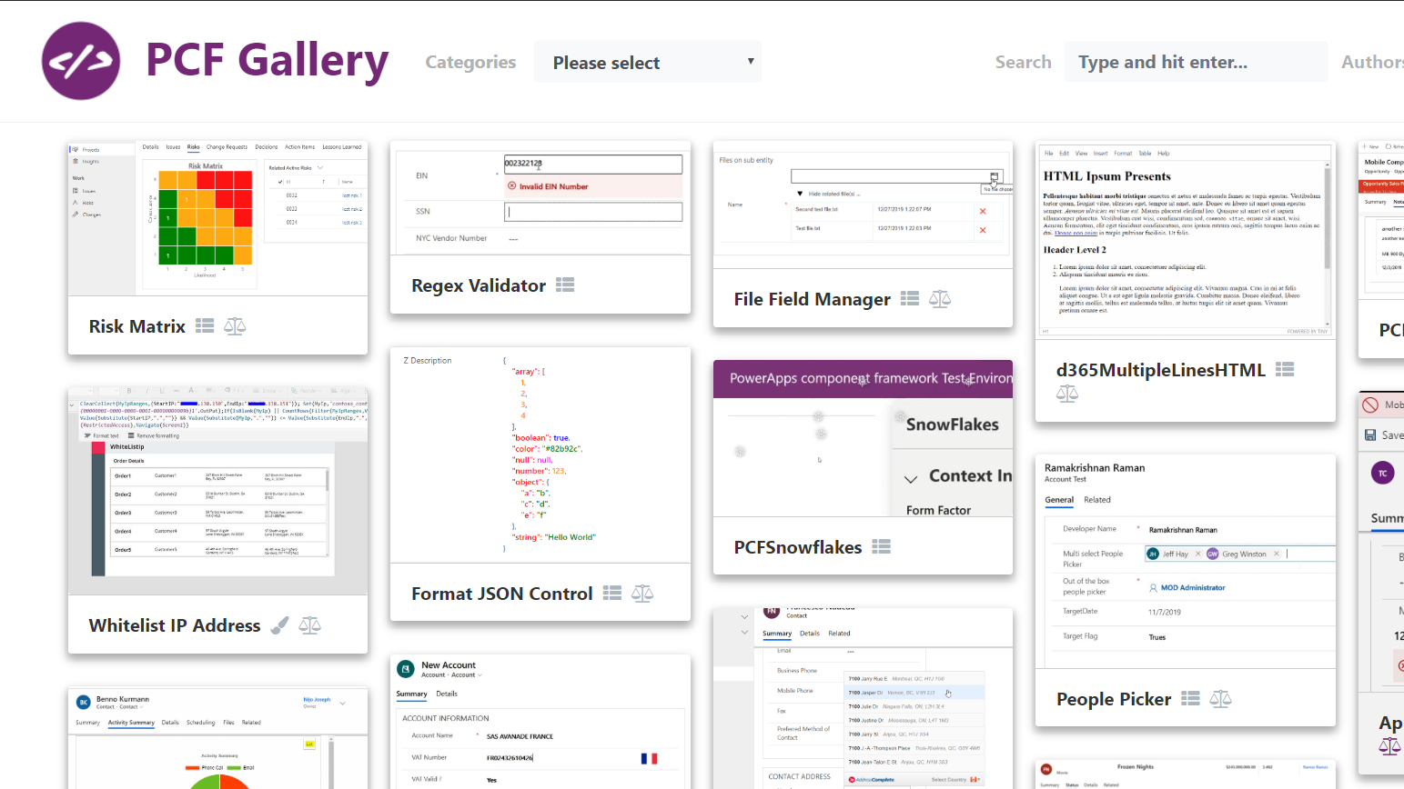
Community
PCF Gallery created by Guido Preite (@crmanswers): https://pcf.gallery/
Notes:
What if you need to find a specific component? Is there any place to search? And the answers - this place exists. Check out pcf.gallery created by Microsoft MVP Guido Preite. There you can find all community-created component, submit an idea of a new component and a lot of other things

Slide 8
Commercial products
Maplytics by Inogic
Map My Relationships by Inogic
Kanban Board by Inogic
SalesSpark
Notes:
But the community is not the only one utilizing PCF. A lot of companies created successful commercial products using it.

Slide 9

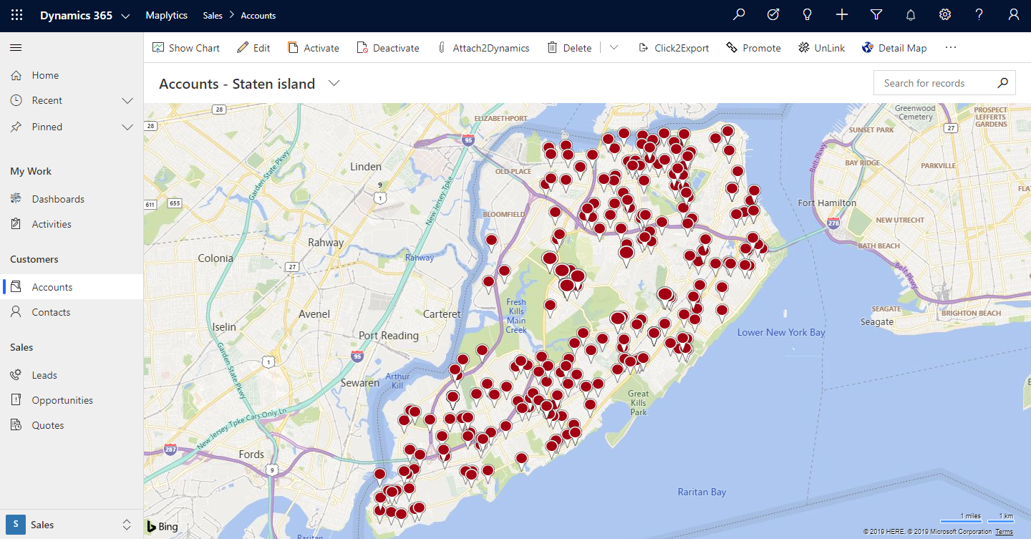
Maplytics by Inogic
Source: maplytics.com

Slide 10
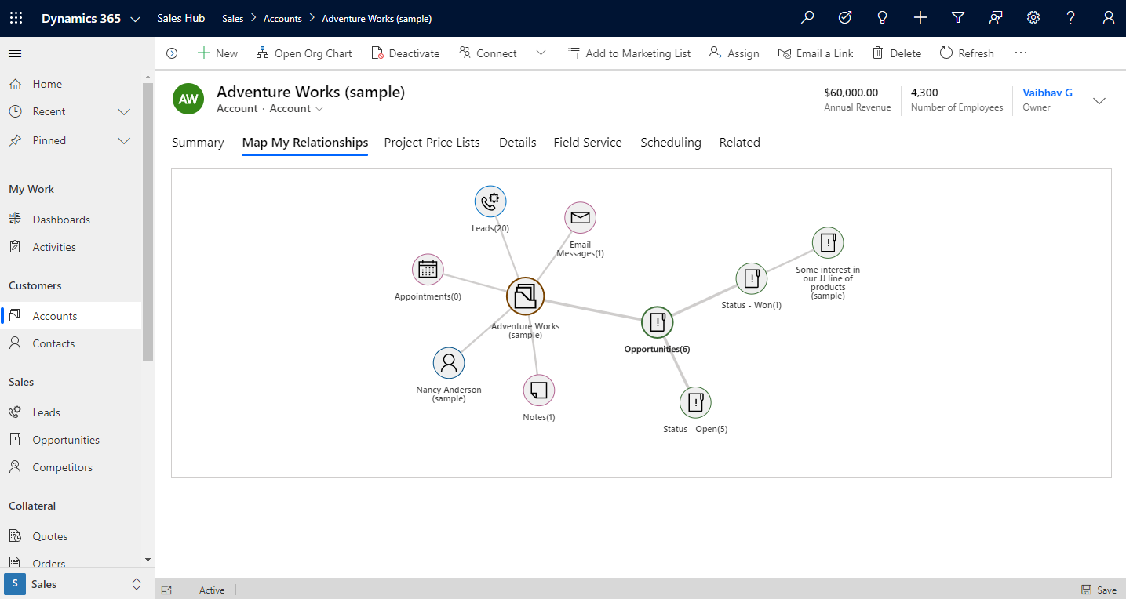
Map My Relationships by Inogic
Source: Inogic Blog

Slide 11
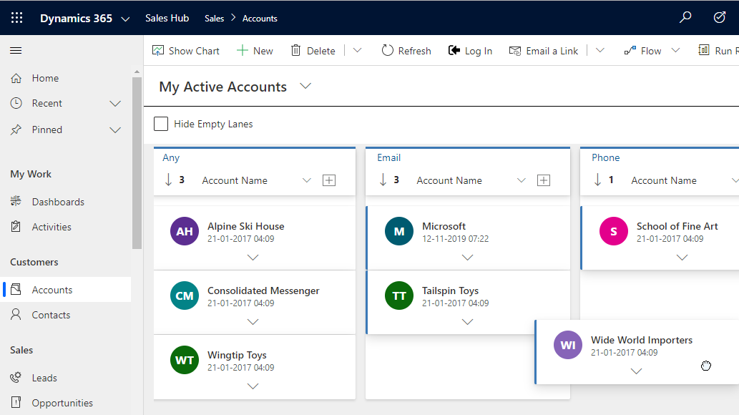
Kanban Board by Inogic
Source: Inogic Blog

Slide 12
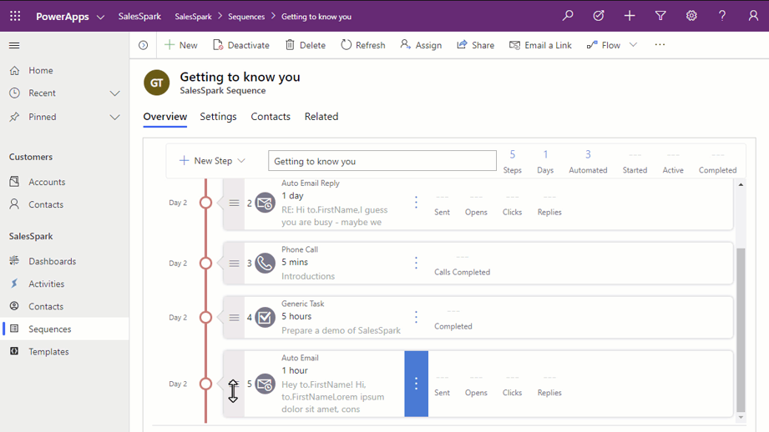
SalesSpark
Source: salesspark.com

Slide 13
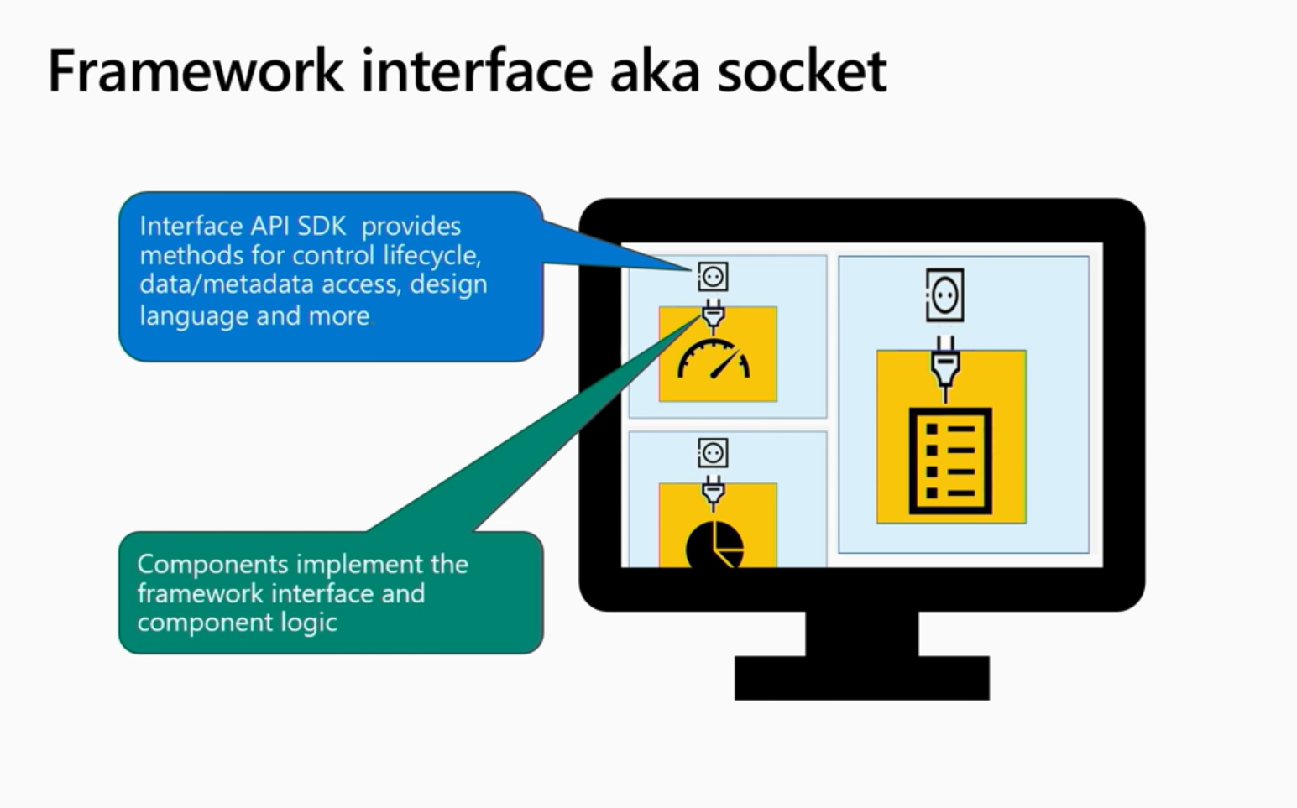
How to build a component
Source: PowerApps component framework - BRK2037

Slide 14
How to build a component
Component lifecycle methods
init()
updateView()
destroy()
getOutputs()

Slide 15
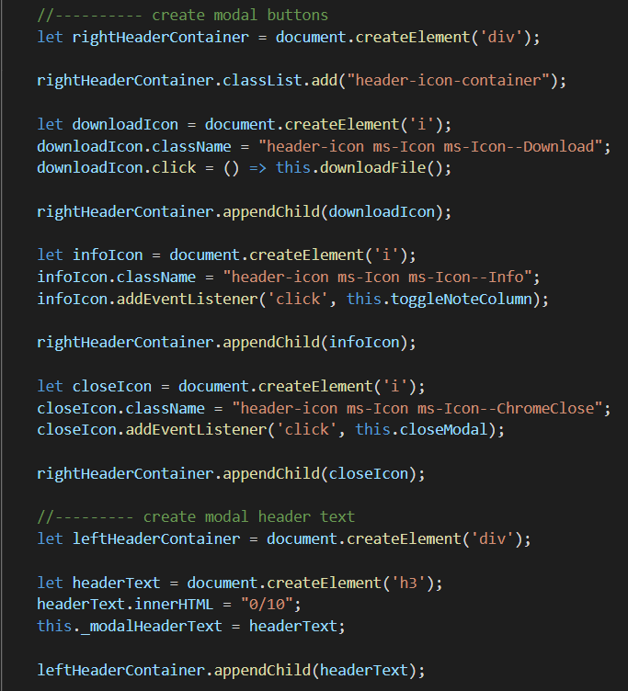

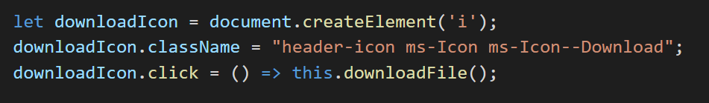
How to build a component

Slide 16



Front-end frameworks to the rescue

Slide 17
Why React?
Declarative
Component-based
Reusable
Composable
Simple

Slide 18

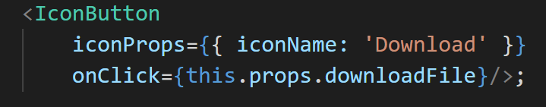
Why React?

Slide 19
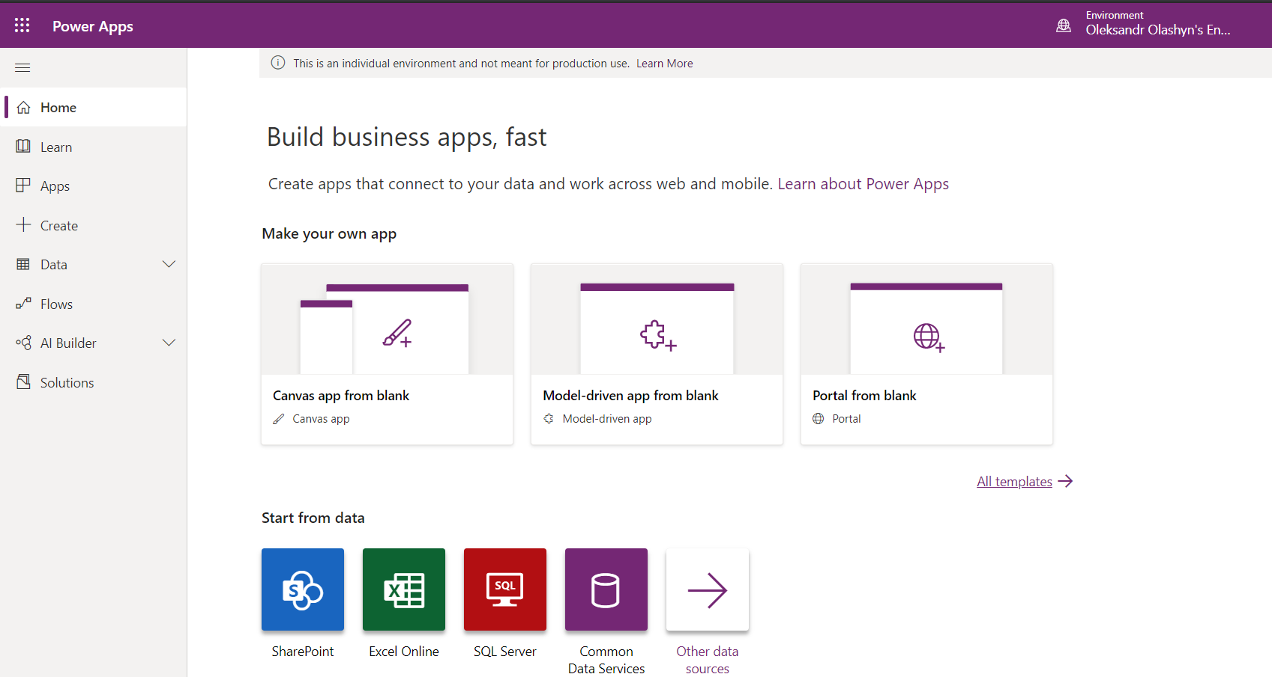
Notes:
Microsoft used React to creating new UI and new maker experience.

Slide 20
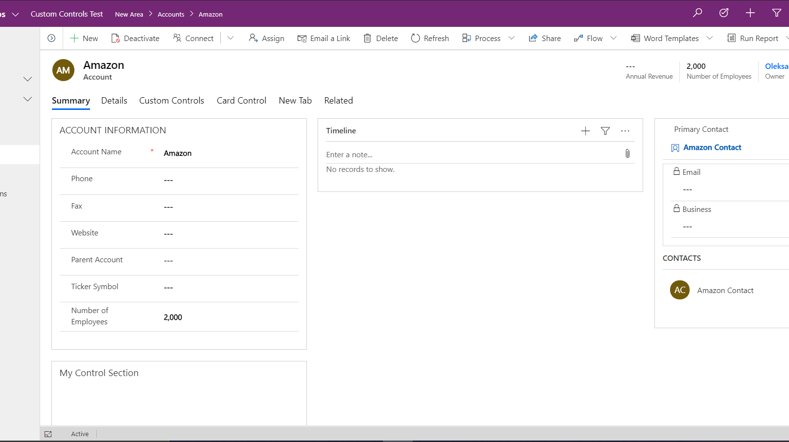

Slide 21
Performance improvement
63% for grid loads
37% for form loads
27% for app launches
Source: Performance benefits of unified interface – Power Apps Blog

Slide 22
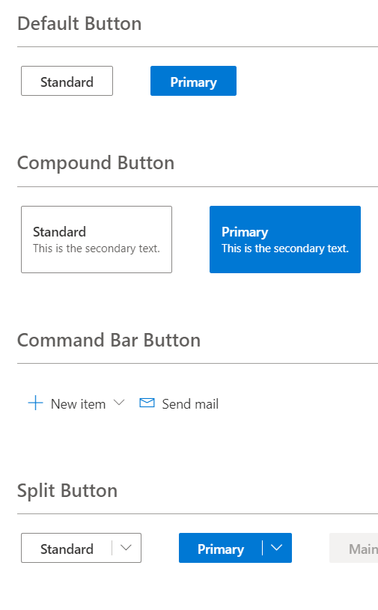
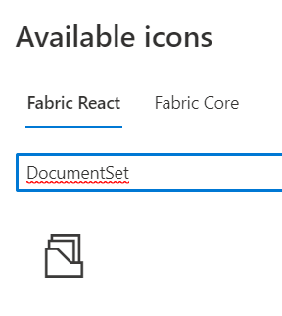
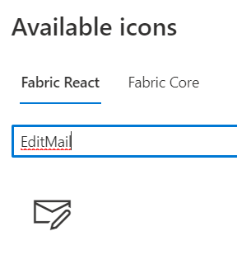
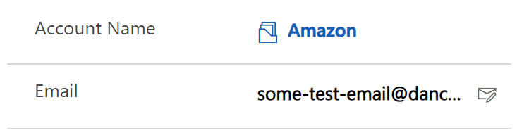
Office Fabric UI React
Notes:
Create an amazing user experience that will feel like a native part of the system with Office Fabric UI.

Slide 23
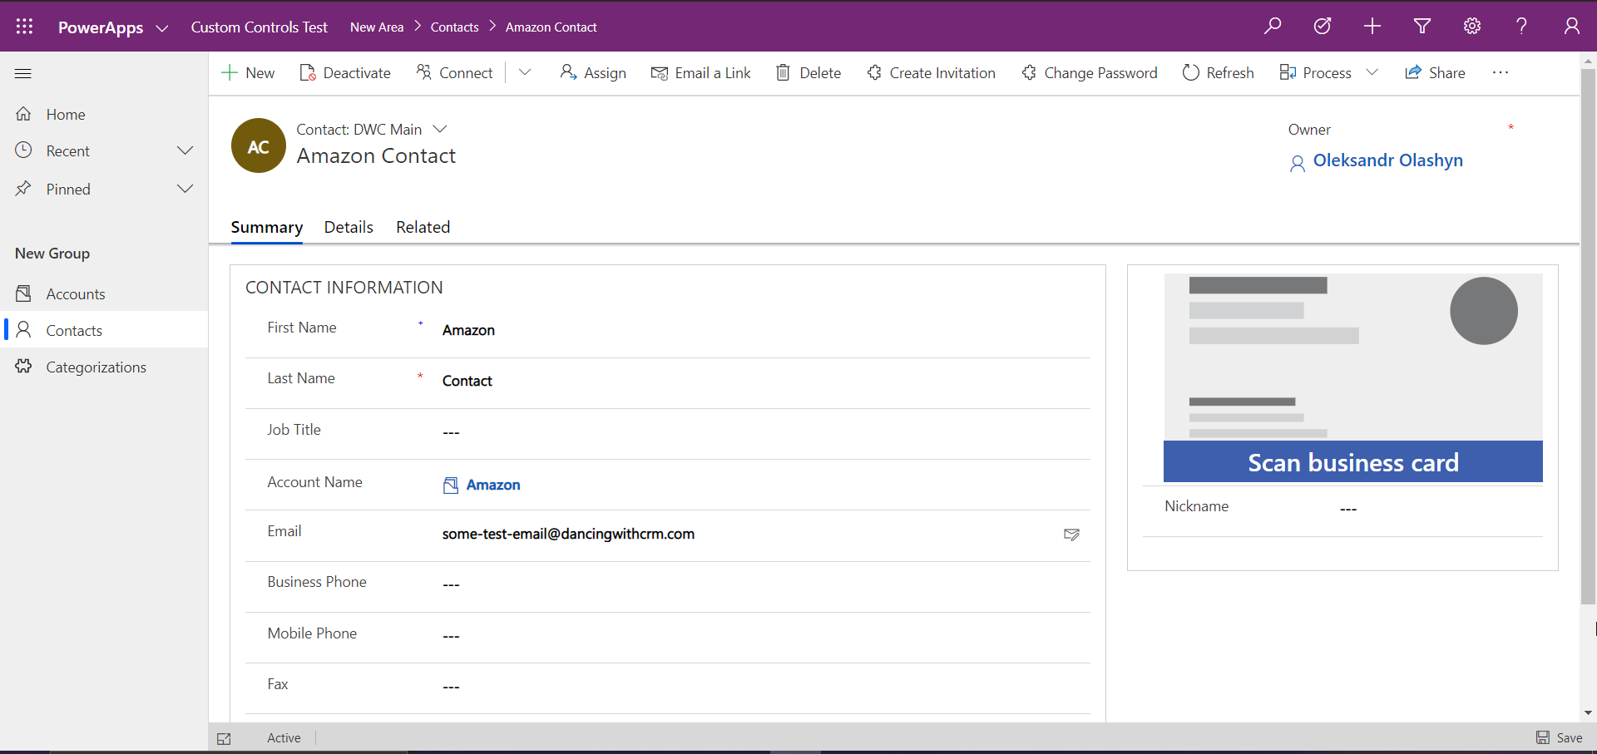
Notes:
The main reason to use React is thinking in components. Take a look at the screen. This is a native UI of the system that you see every day. Try to imagine how would you split it into the reusable components. Don't focus on a single button, try to have a wider perspective.

Slide 24
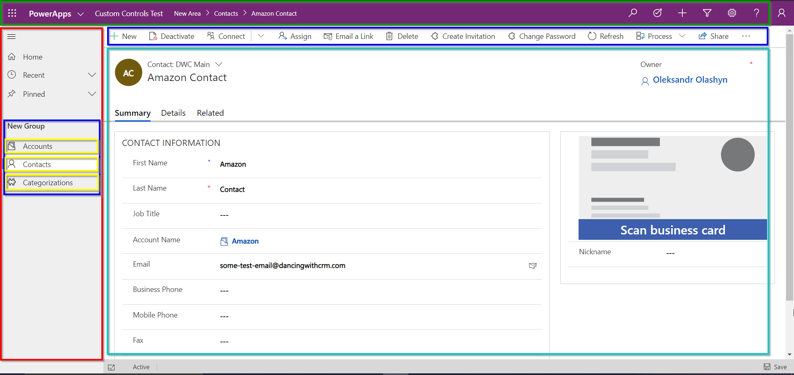
Notes:
Sample component split

Slide 25
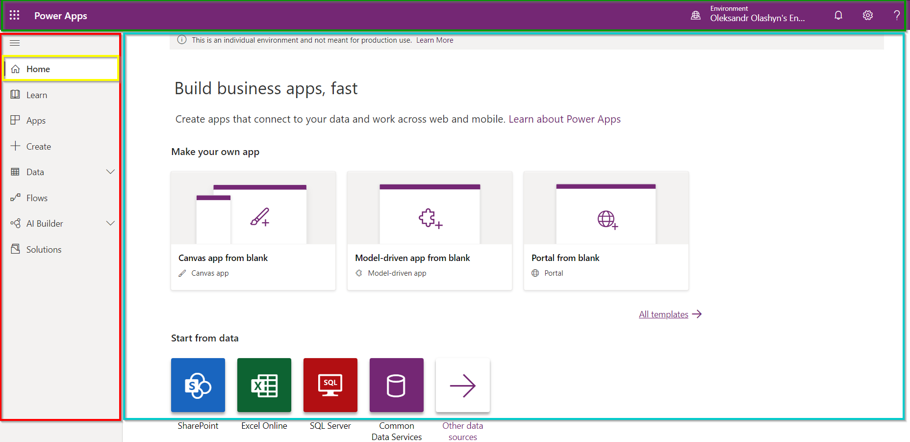
Notes:
See how Microsoft reuses its components in the maker experience as well.

Slide 26
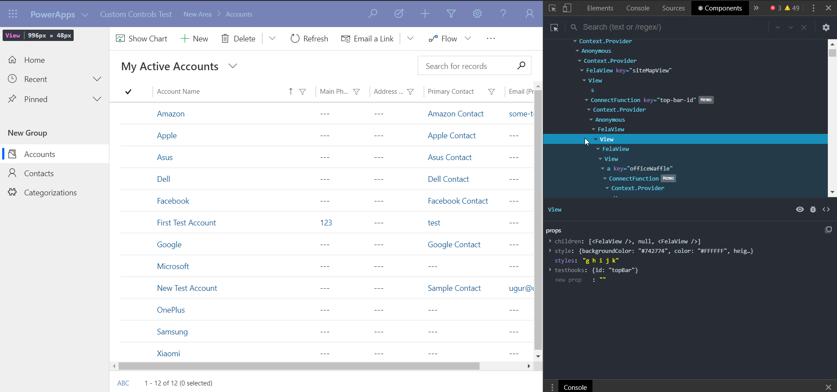
Notes:
You can inspect components in the web using Reach Dev Tool Chrome extension.

Slide 27
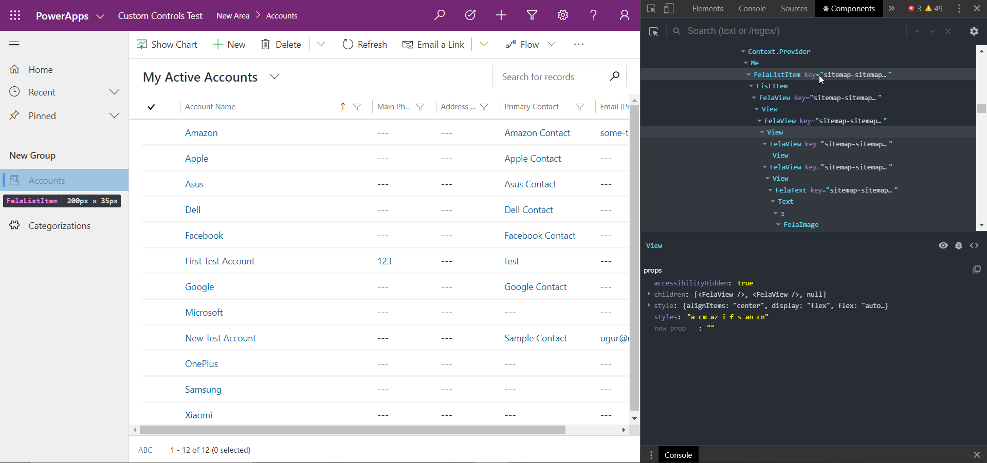

Slide 28
Limitations
Copy of React (or any 3rd party) library will be loaded with each component
No out of the box support for JSX and TSX
Calling one component from another is not supported

Slide 29
Demo

Slide 30
QnA

Slide 31

Useful links
Getting started with React: https://reactjs.org/
Office Fabric UI: https://developer.microsoft.com/en-us/fabric#/
PCF official docs: https://docs.microsoft.com/en-us/powerapps/developer/component-framework/overview
React DevTools Chrome Extension: https://chrome.google.com/webstore/detail/react-developer-tools/fmkadmapgofadopljbjfkapdkoienihi
My demos and presentation: https://github.com/OOlashyn/PPSWarsaw2020

Slide 32

Fill out an evaluation
Help us make PPSWarsaw better
https://aka.ms/ppswarsaw

Slide 33
Thank you for your attention

